Slide 1
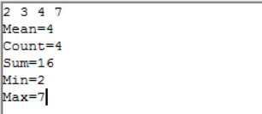
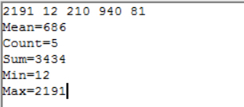
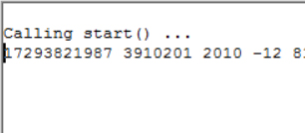
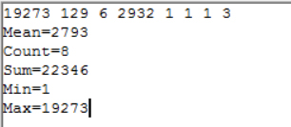
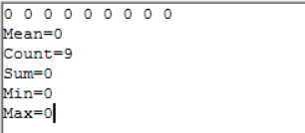
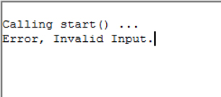
2, 3, 4, 7
2191, 12, 210, 940, 81
17293821987, 3910201, 2010, -12, 81
1927293, 129, 6, 2932, 1, 1, 1, 3
0, 0, 0, 0, 0, 0, 0, 0, 0
Null
✔
✔
✘
✔
✔
✔

